Slide 2
Question 123.21.6
Does a wave on a string move faster for a heavier or lighter rope?
yes
no

Slide 3
Question 123.21.7
A wave is traveling on a rope. Does the wave speed increase or decrease as you pull harder on a rope
Increase
Decrease

Slide 4
Question 16.9
A wave travels across a boundary between two different weight ropes. If it goes from the heavier to the lighter rope, the wave speed
Increases
Decreases
Stays the same
Can’t tell

Slide 5
Question 16.10
A wave travels across a boundary between two different weight ropes. If it goes from the lighter to the heavier rope, the reflected wave
Is inverted
Is not inverted
Can’t tell

Slide 6
Question 16.11
If one end of the rope is fixed to a pole, the reflected wave is inverted because
The rope dissipates energy so the pulse must be lower to account for the lower potential energy
The pole exerts an equal but opposite force on the end of the rope, so it is forced downward
The pull of gravity increases for the end of ropes
Can’t tell

Slide 7
Question 123.21.8
The speed of sound in water is about 1.4km/s. Will the speed of sound be faster or slower in air?
Faster
Slower
Can’t tell

Slide 8
Example

Slide 9
Amplitude

Slide 10
Effect of φ
Same example, but with different values of φ

Slide 11
Case One: Fixed End
There is a big change in the medium at the end of the rope.
The rope ends.
There is a person or (as in the figure) some thing holding the rope in place.
This change in medium causes a reflection.
In the fixed end case, the pulse is inverted.
Why?

Slide 12
0s
4s
1s
5s
2s
6s
3s
7s

Slide 13
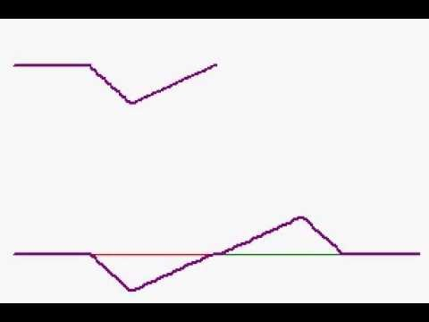

Slide 14
Forces on the End of the Rope
T_{y}
T_{y}
T
T_{y}
T_{x}
F_{g}
T_{x}
F_{wall}
F_{g}
T
F_{wall}

Slide 15
Reasonable?
Remember back in PH 121 (or statics) the book on the table?
Book has a force due to gravity
Table exerts a force equal to m_{book}g on the book

Slide 16
Demo
See if you can feel that you must provide the force

Slide 17
0s
4s
1s
5s
2s
6s
3s
7s

Slide 18
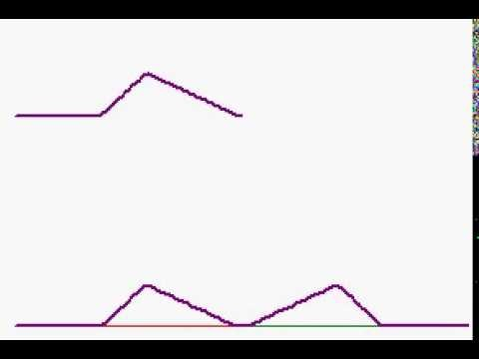

Slide 19
Forces on the End of the Rope
T_{y}
T_{y}
T
T_{y}
T_{x}
F_{g}
T_{x}
F_{g}
T

Slide 20
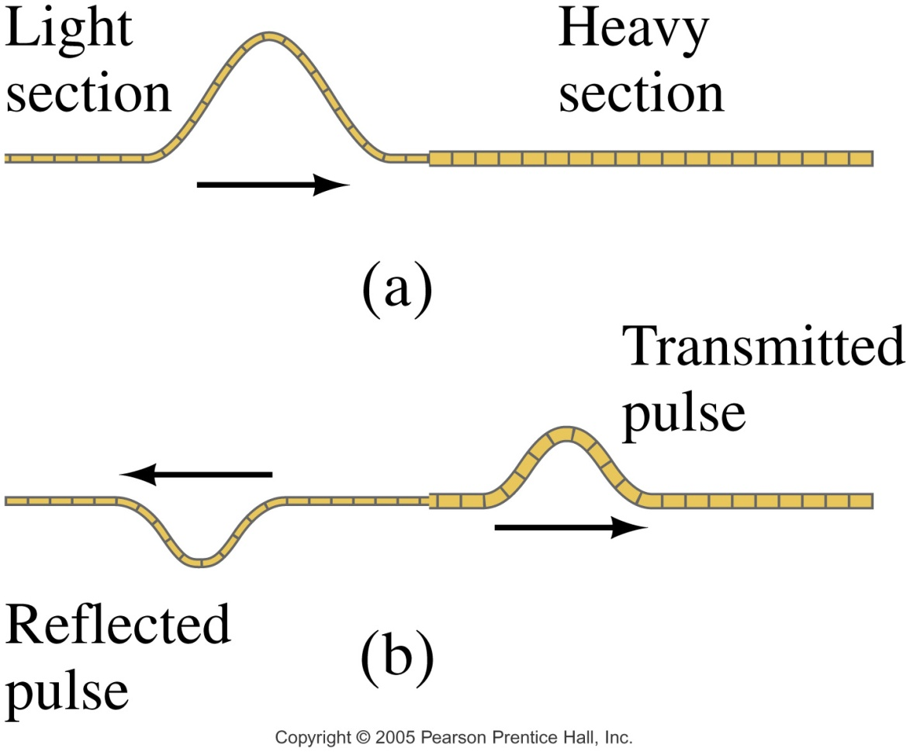
Case 3: Semi-loose End
Now the pulse is partially reflected
RHS rope sees a semi-fixed end point
LHS receives part of the pulse energy
New pulse has been “transmitted”

Slide 21
Forces on the End of the Rope
T_{y}
T_{y}
T
T_{y}
T_{x}
F_{g}
T_{x}
F_{RHS}
F_{g}
F_{RHSl}
T

Slide 22
Consider momentum
When we move from a less dense medium to a more dense medium
Reflected pulse is inverted
Pulse slows down
Which piece is harder to move?

Slide 23
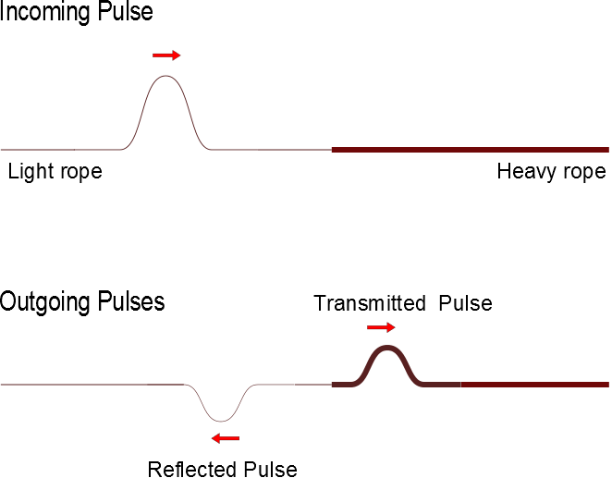
Superposition With and Inverted Pulse

Slide 24
Anti-Nodes
Nodes

Slide 26
L

Slide 27
Question 223.6.6 Question 123.23.9
The nodes of a standing wave occur at
And the antinodes occur at
Can’t tell

Slide 28
Question 223.6.7 Question 123.23.10
I have my trusty ukulele and I have a string experiencing a standing wave. Which frequency corresponds to this wave shown?
The fundamental
The second harmonic
The third harmonic
The fourth harmonic

Slide 29
Question 18.2
Two identical waves travel in opposite directions in a medium. If each wave has amplitude, A, the maximum amplitude of the resultant wave would be
A
2A
4A
A/2

Slide 30
Question 18.3
Does the node of a standing wave move in the x direction?
Yes
No

Slide 31
Question 18.4
The nodes of a standing wave occur at
And the antinodes occur at
Can’t tell

Slide 32

Question 18.5
A string is clamped at both ends and plucked so it vibrates in a standing mode between two extreme positions a and b. Let upward motion correspond to positive velocities. When the string is in position c, the instantaneous velocity of points along the string:
1 is zero everywhere.
2 is positive everywhere.
3 is negative everywhere.
4 depends on location.
a
c
b

Slide 33

Answer
D).
P
R
Q

Slide 34
Question 18.6
A string is clamped at both ends and plucked so it vibrates in a standing mode between two extreme positions a and b. Let upward motion correspond to positive velocities. When the string is in position b, the instantaneous velocity of points along the string
is zero everywhere.
is positive everywhere.
is negative everywhere.
depends on location
a
c
b

Slide 35

Answer
A)
R
Q
P

Slide 36
Summary
Superposition
Standing Waves

Slide 37
Summary
Standing Waves in Strings

